Slide 1
Unit 9: Swine
Chapters 29 & 30

Slide 2
Objectives
Understanding of breed characteristics, traits, and measurements
Knowledge of performance data
Comprehension of genetic selection, and the use of crossbreeding
Awareness of various swine management systems, feeding, and the environment

Slide 3
Characteristics of Swine Breeds
Generally grouped by:
Hair color
Dropping or erect ears
Popularity of breeds has changed with time & technology
Hybrids becoming common
Hybridization began in the 1940’s
Selected by objective production measurements

Slide 4
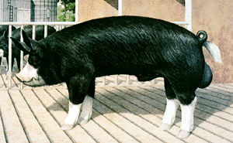

Slide 5
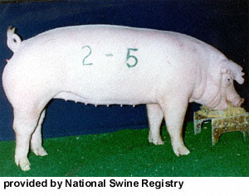

Slide 6
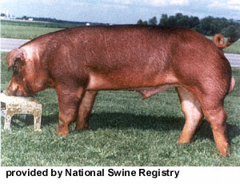

Slide 7
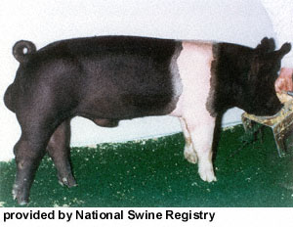

Slide 8
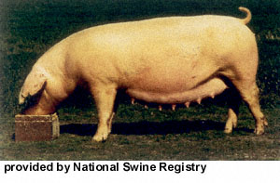

Slide 9
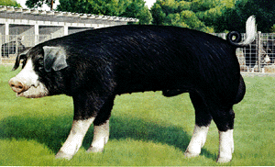

Slide 10
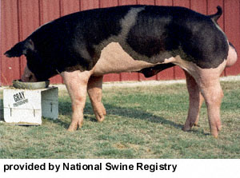

Slide 11
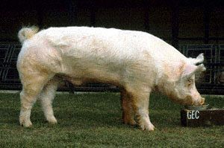

Slide 12
Traits & their Measurements
Sow Productivity
Litter size
Number weaned/litter
21d litter weight
Litters/yr.
Traits are not highly heritable, so management must select for them, and manage through feeding and health
Crossbreeding can help improve productivity

Slide 13
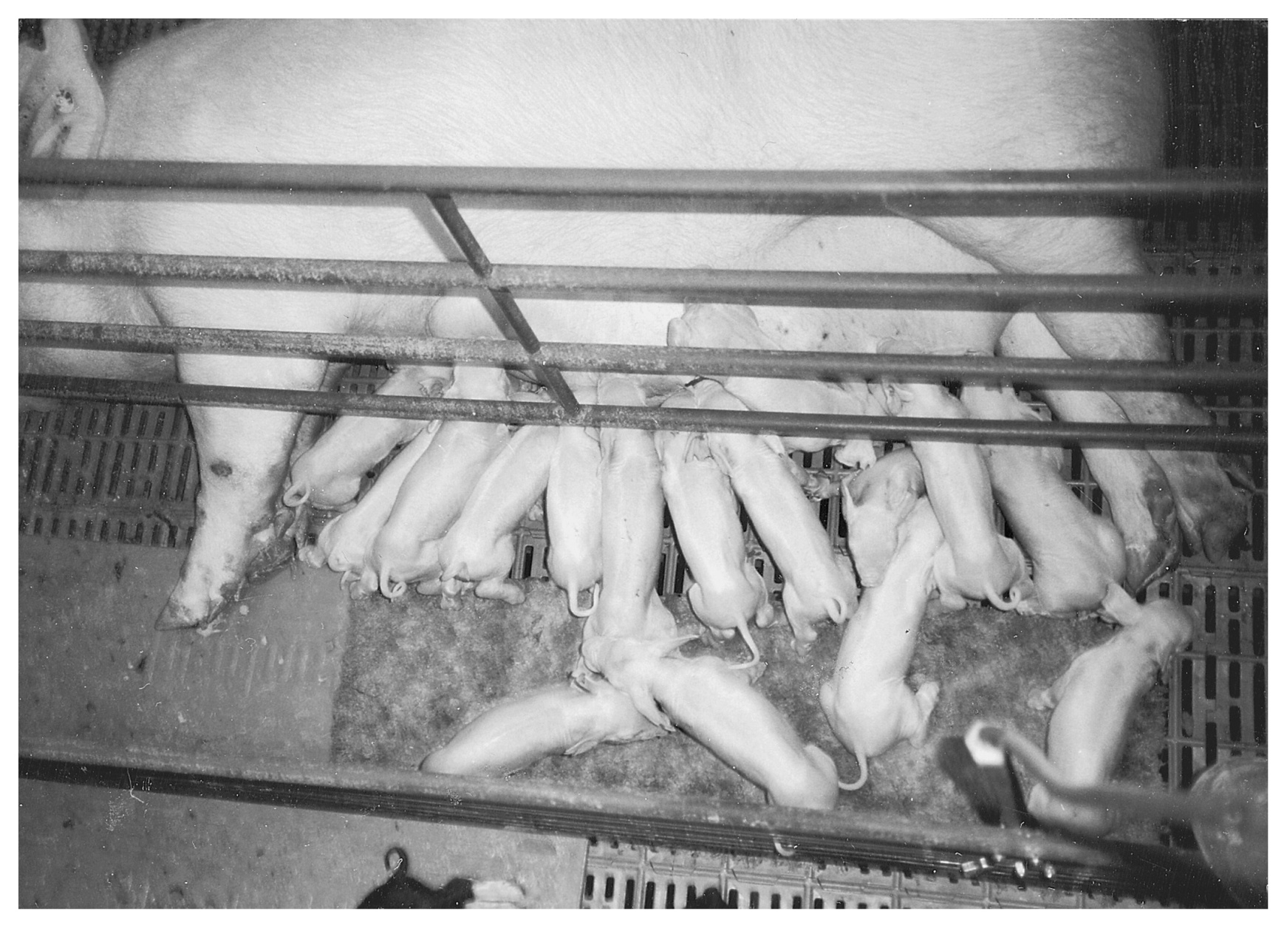
Figure 29.2 The number of pigs raised per sow and the weight of the litter at 21 days of age effectively measure sow productivity. Courtesy of the National Swine Registry.

Slide 14
Traits & their Measurements
Growth
Growth Rate is 35% heritable
Can be effectively used in genetic selection
Measured by # of days to reach 260lbs.
Feed Efficiency
Lbs. of feed/lb. of gain
~30% heritable
Crucial b/c feed accounts for 60-70% of cost of production
How do we monitor feed efficiency?

Slide 15
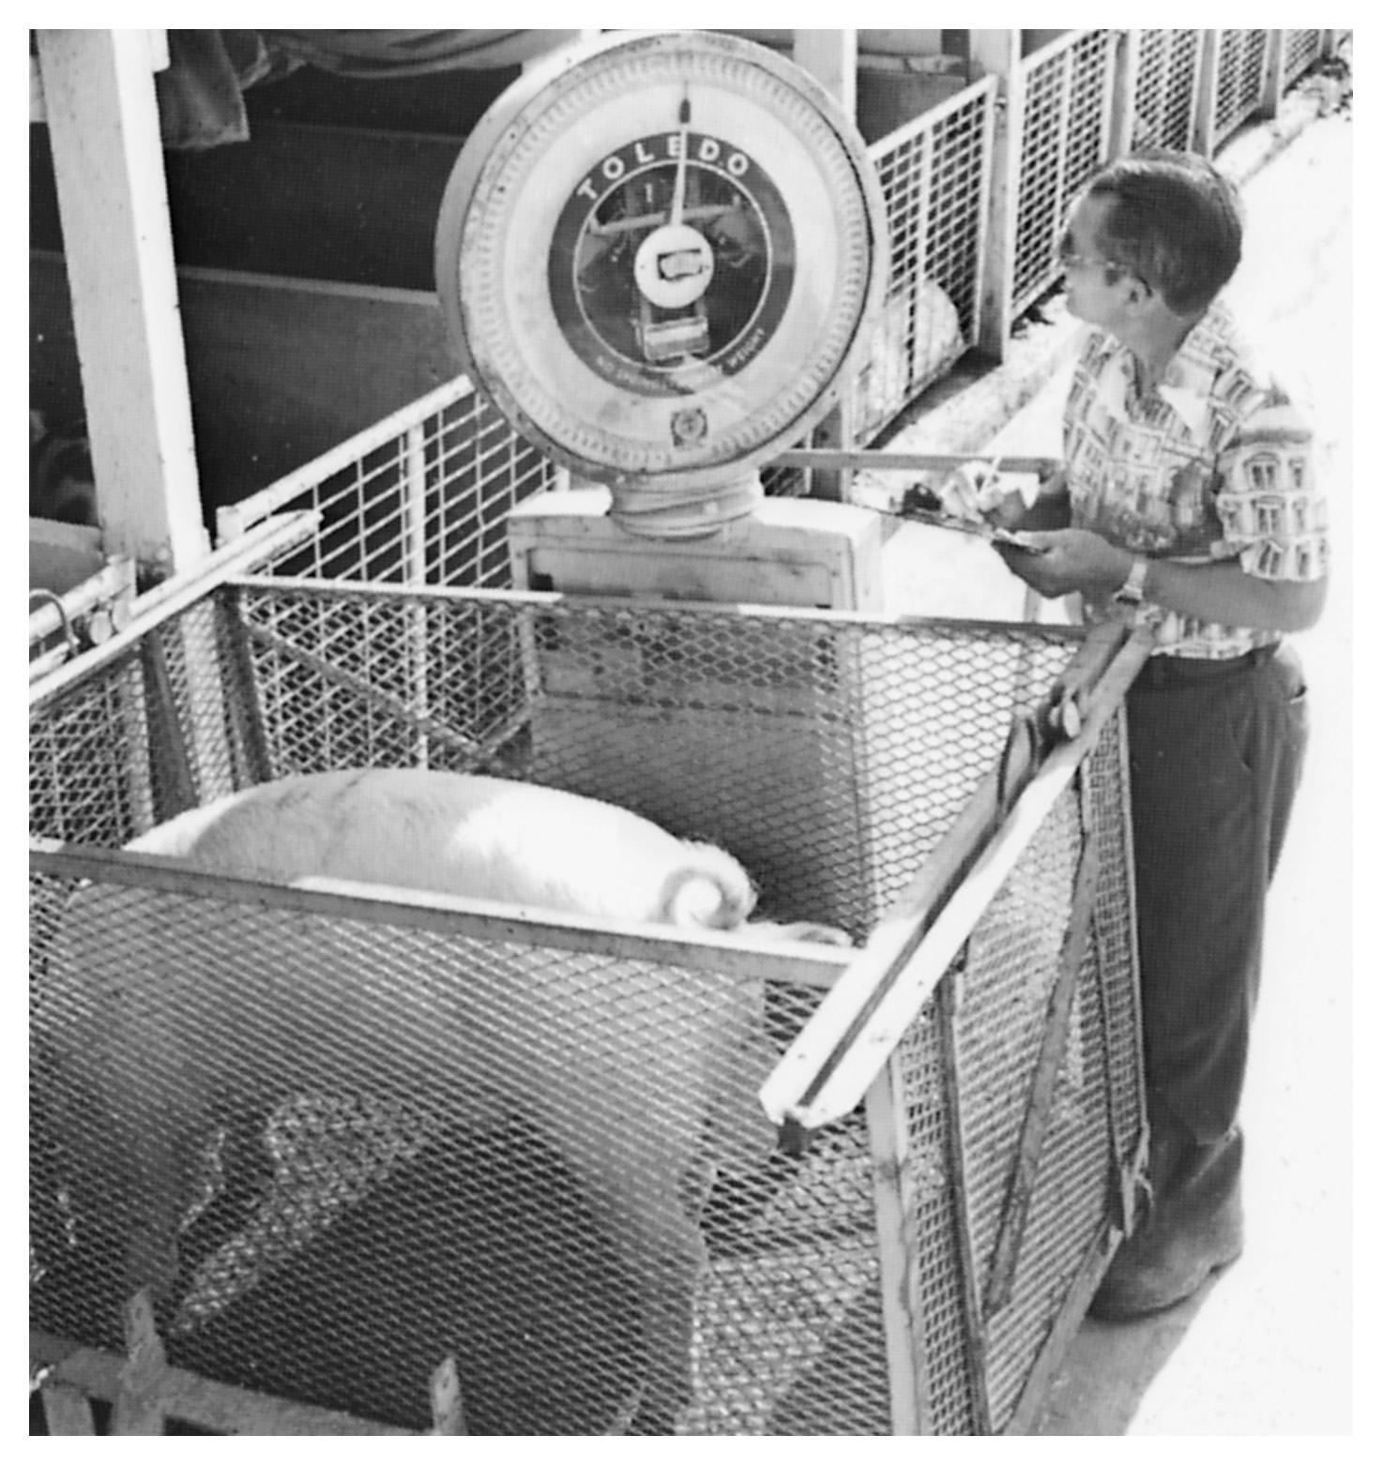
Figure 29.3 Using scales to measure the growth rate of individual boars is an essential part of a sound breeding system. Courtesy of Iowa State University.

Slide 16
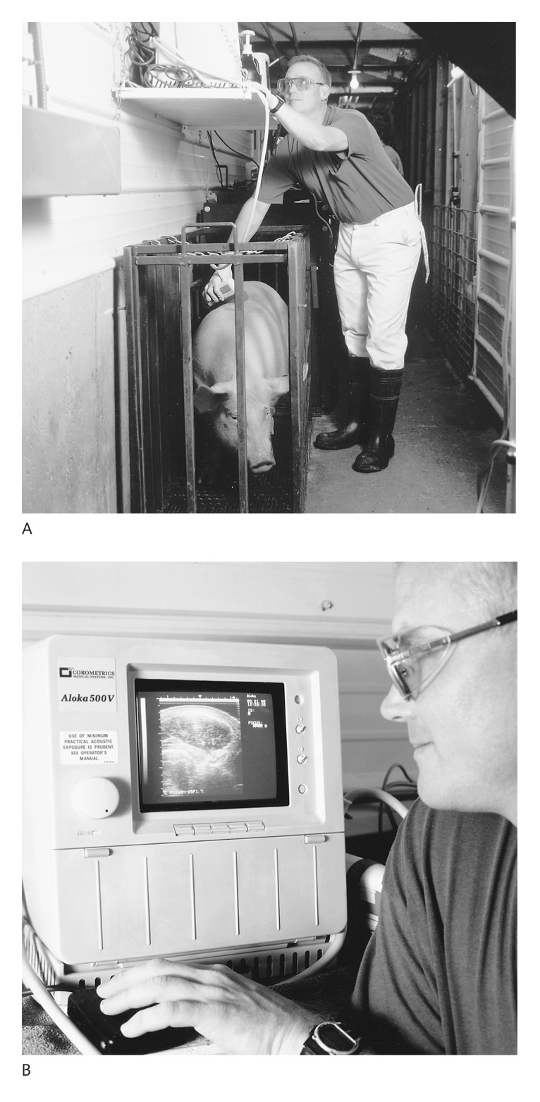
Figure 29.4 (A) Ultrasound measurements being taken on a pig. (B) Screen showing ultrasound image of a loineye and fat deposition (above the loineye muscle) from the pig shown in (A). Courtesy of Monsanto Choice Genetics.

Slide 17
Traits & their Measurements
Carcass Traits
Used to estimate lbs. or % acceptable quality lean pork (10% fat) in the carcass
~48% heritable
3 traits used to predict
Fat depth over loin at the tenth rib
Loin muscle area
Carcass muscling score
Can be predicted on live pigs by using ultrasound on backfat, or a well-trained eye

Slide 18
Traits & their Measurements
Structural Soundness
Capability of breeding and slaughter animals to withstand the rigors of confinement and breeding
Is somewhat heritable
Unsound pigs are generally culled
Inherited defects
Cryptorchidism
Retention of one or both testicles
Hernias
Umbilical
Scrotal

Slide 19
Traits & their Measurements
Inverted nipples
Pale, soft, exudative (PSE) carcasses
Porcine Stress Syndrome (PSS)
Due to extreme muscling
Results in death or PSE meat
Can be equal to non PSS pigs, but have a 30-50% risk of PSE

Slide 20
Effective Use of Performance Records
Two influential factors
Genetics
Environment
4 features of sound genetic improvement program
Accurate, complete performance records & animal ID
Assessment of genetic merit of important traits
Indexes relating traits to economic importance in commercial pork production
Selection of highest ranked boars & gilts based on selection data
Rate of genetic improvement is parallel with the seedstock source

Slide 21
Effective Use of Performance Records
Several genetic evaluation programs
STAGES (Swine Testing and Genetic Evaluation System)
Computes 21d litter weight, no. born alive
EPD’s are reported for backfat, loineye area, pounds of fat-free lean adjusted to 250lbs., days to 250lbs., feed/lb. of gain
SPI (Sow Productivity Index)-no. born alive, no. weaned, litter weight
Each unit SPI = $1/litter produced

Slide 22
Effective Use of Performance Records
TSI (Terminal Sire Index)-useful in crossbreeding, only includes postweaning traits
Each unit = $1/10 pigs marketed
MLI (Maternal Line Index)-evaluates gilts for replacement
Uses both maternal & terminal traits
Results expressed as EPD’s
EPD (Expected Progeny Difference)
Prediction of progeny performance compared to the average
Expressed as +/-
Average EPD set at 0

Slide 23
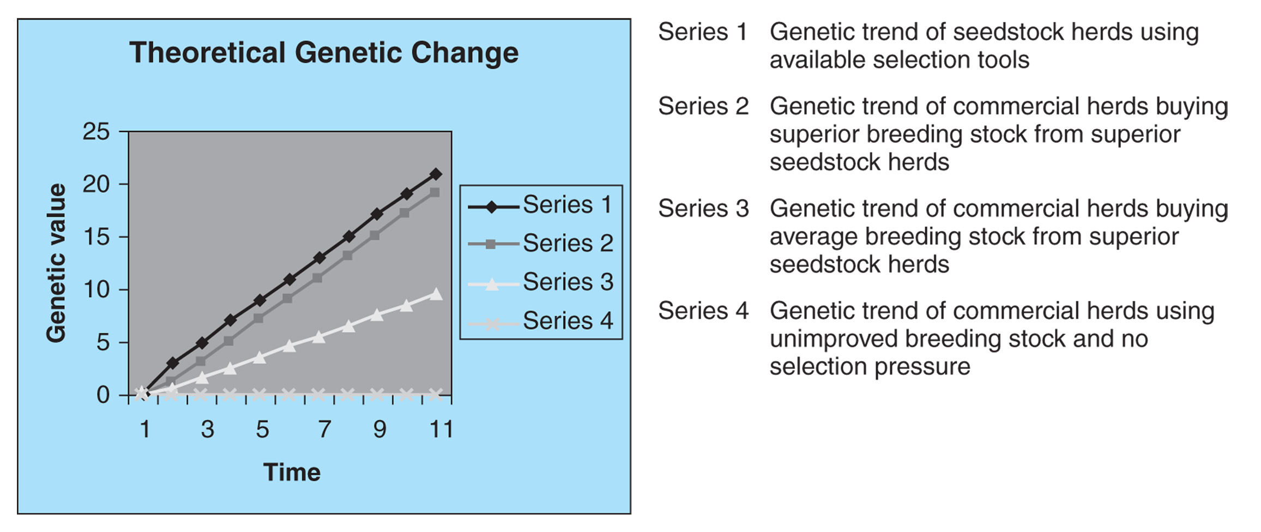
Figure 29.5 Comparison of genetic trends under various selection strategies. Source: Adapted from Pork Industry Handbook (PIH-9).

Slide 24
Selecting Replacement Females
Foundation of commercial pork production
Select
Fast growing
Sound
Moderate lean
Good body capacity
From litters where 8-14 excellent pigs were weaned

Slide 25
Selecting Replacement Females
Sows that farrow and will rebreed
Evaluate and cull:
Physical problems
Poor disposition
Small litters (2 pigs below herd ave.)
Poor mothering record
Must have enough gilts to replace culled sows
Suggested replacement rate is 20-25%
What happens is you are higher/lower?

Slide 26
Birth | ID gilts, all gilts are disqualified if any members of the litter have defects, record birth date, litter size, note sow behavior
3-5 wks. | 21d litter wt., wean, reject gilts w/ <12 teats, want to ID ~2-3x more gilts than needed for replacement
180-200lbs. | Wt., ultrasound backfat, check soundness, select fast growing lean gilts from lg. litters, 25-30% more than needed, separate selected gilts from market hogs, check for sexual maturity
Breeding time | Keep enough gilts to offset nonconception rate, mark and tag

Slide 27
Litter size | >10 farrowed, >8 weaned
Underline | 12 fully developed, well-spaced
Feet & legs | Wide stance, free movement, good cushion equal size toes
Age @ 230# | <155d
Feed/gain 60-230# | 240lb feed/cwt gain
Daily gain | >2.0#/d
Backfat Ultrasound | .8” or less

Slide 28
Boar Selection
Selected boars can contribute as much as 80-90% of herd genetic composition over time
Should have dams that are highly productive sows
Effectiveness determined by boar’s ability to pass on traits measured in replacement gilts

Slide 29
Crossbreeding for Commercial Swine Production
Crossing two or more breeds increases chance of hybrid vigor
Most advances in growth rate & leanness
>90% of marketed hogs in commercial production are crossbred
Two types of crossbreeding
Rotational cross
Terminal cross

Slide 30
Crossbreeding for Commercial Swine Production
Rotational Cross
Two + Breeds
Different breed boar is crossed with crossbred offspring of previous generation
Terminal Cross
Crossbred females are mated to a boar of a third breed
Rota-terminal
Combination of both systems
All pigs go to market
Female traits are not selected for

Slide 31
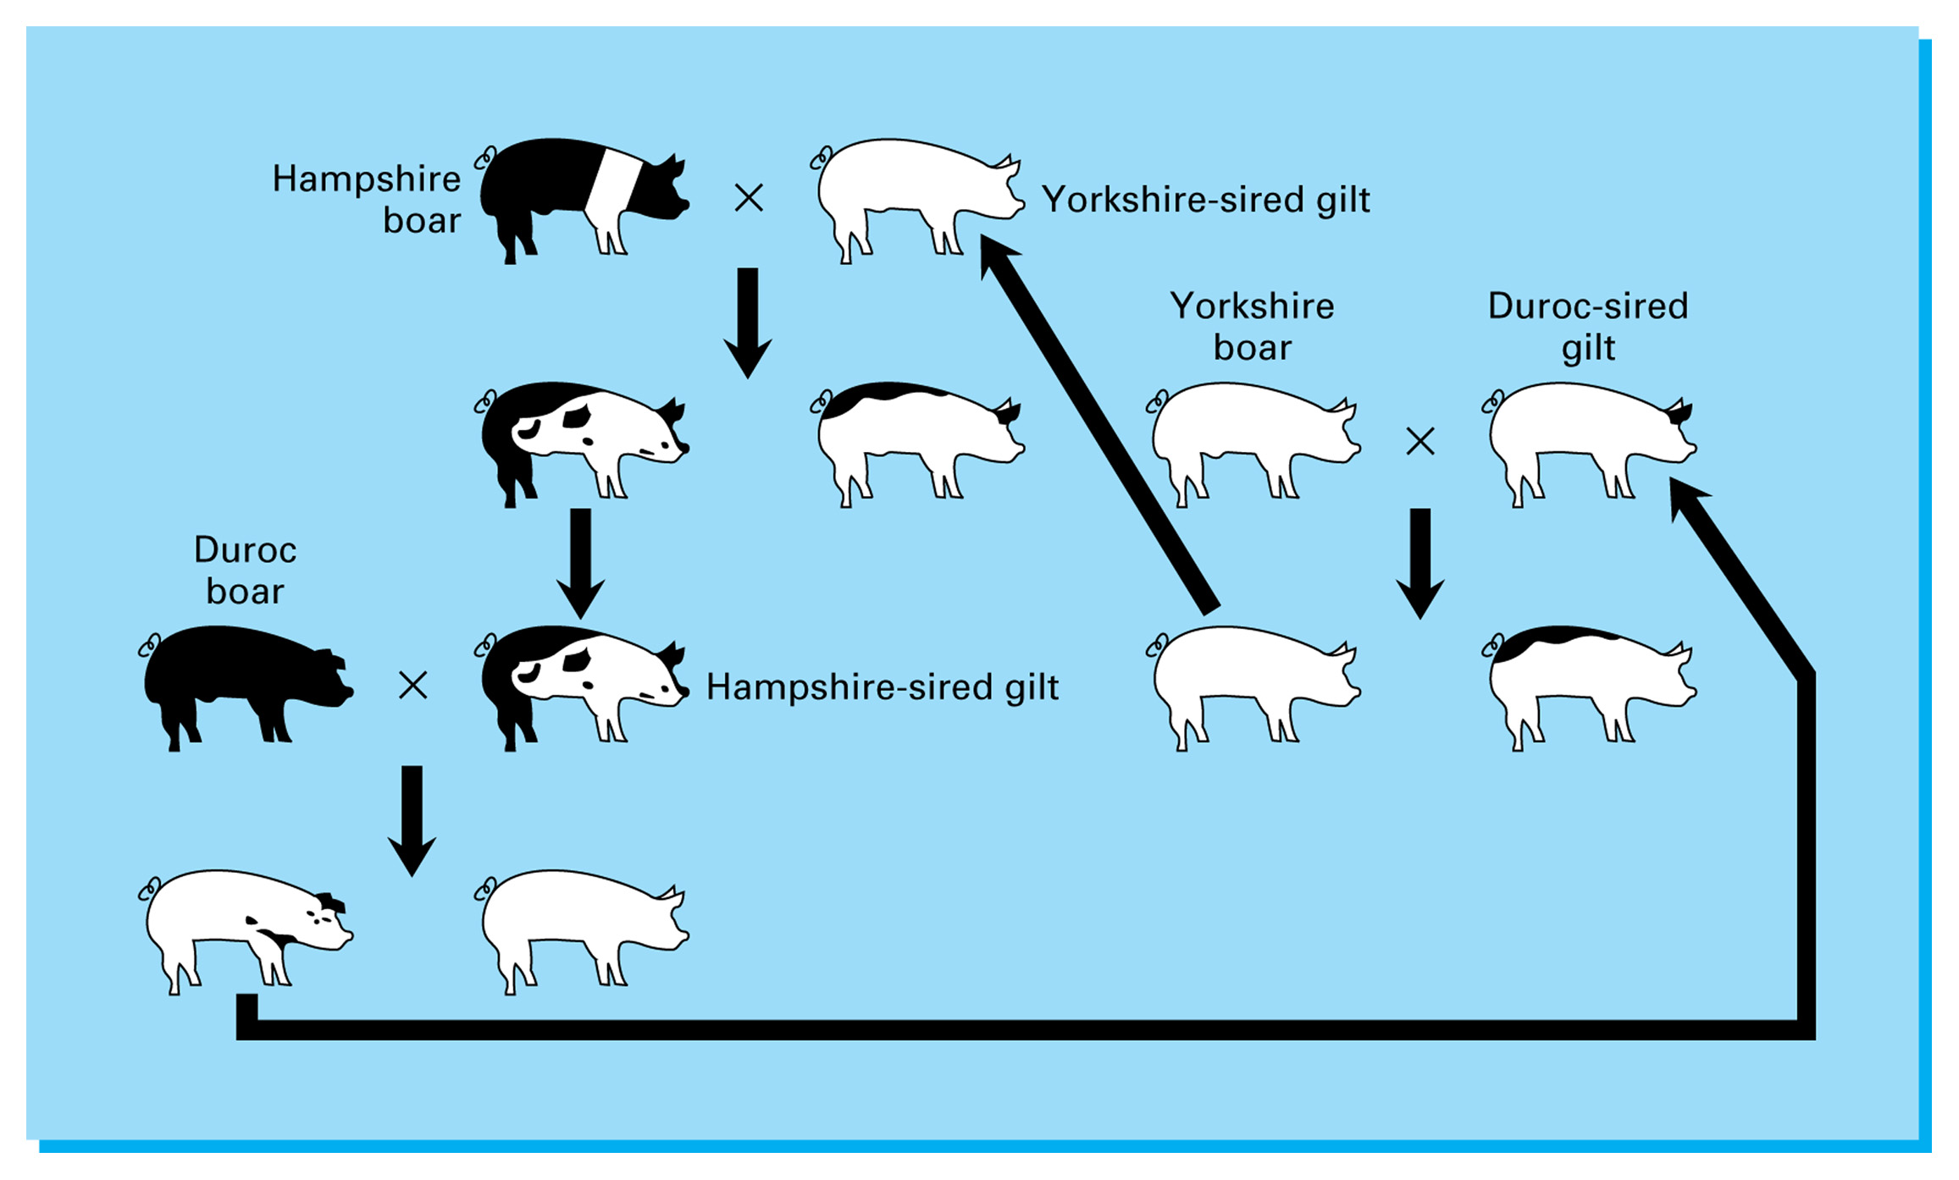
Figure 29.8 Three-breed rotational crossbreeding system. Adapted from Pork Industry Handbook (PIH-39).

Slide 32
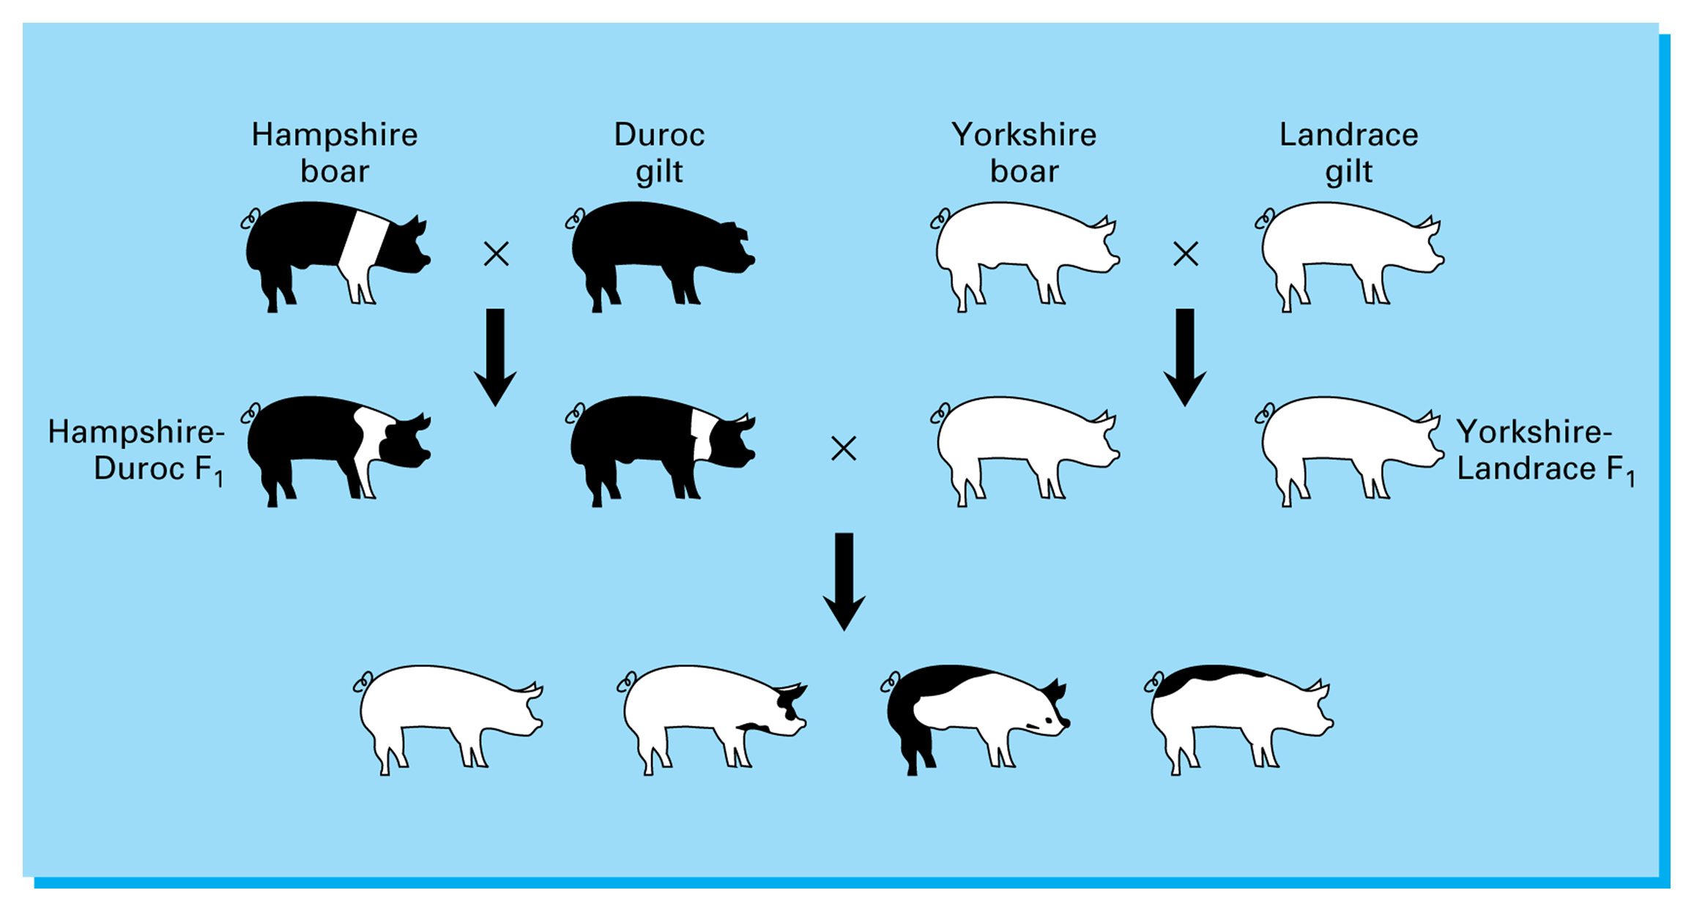
Figure 29.9 Four-breed terminal crossbreeding system. Adapted from Pork Industry Handbook (PIH-39).

Slide 33
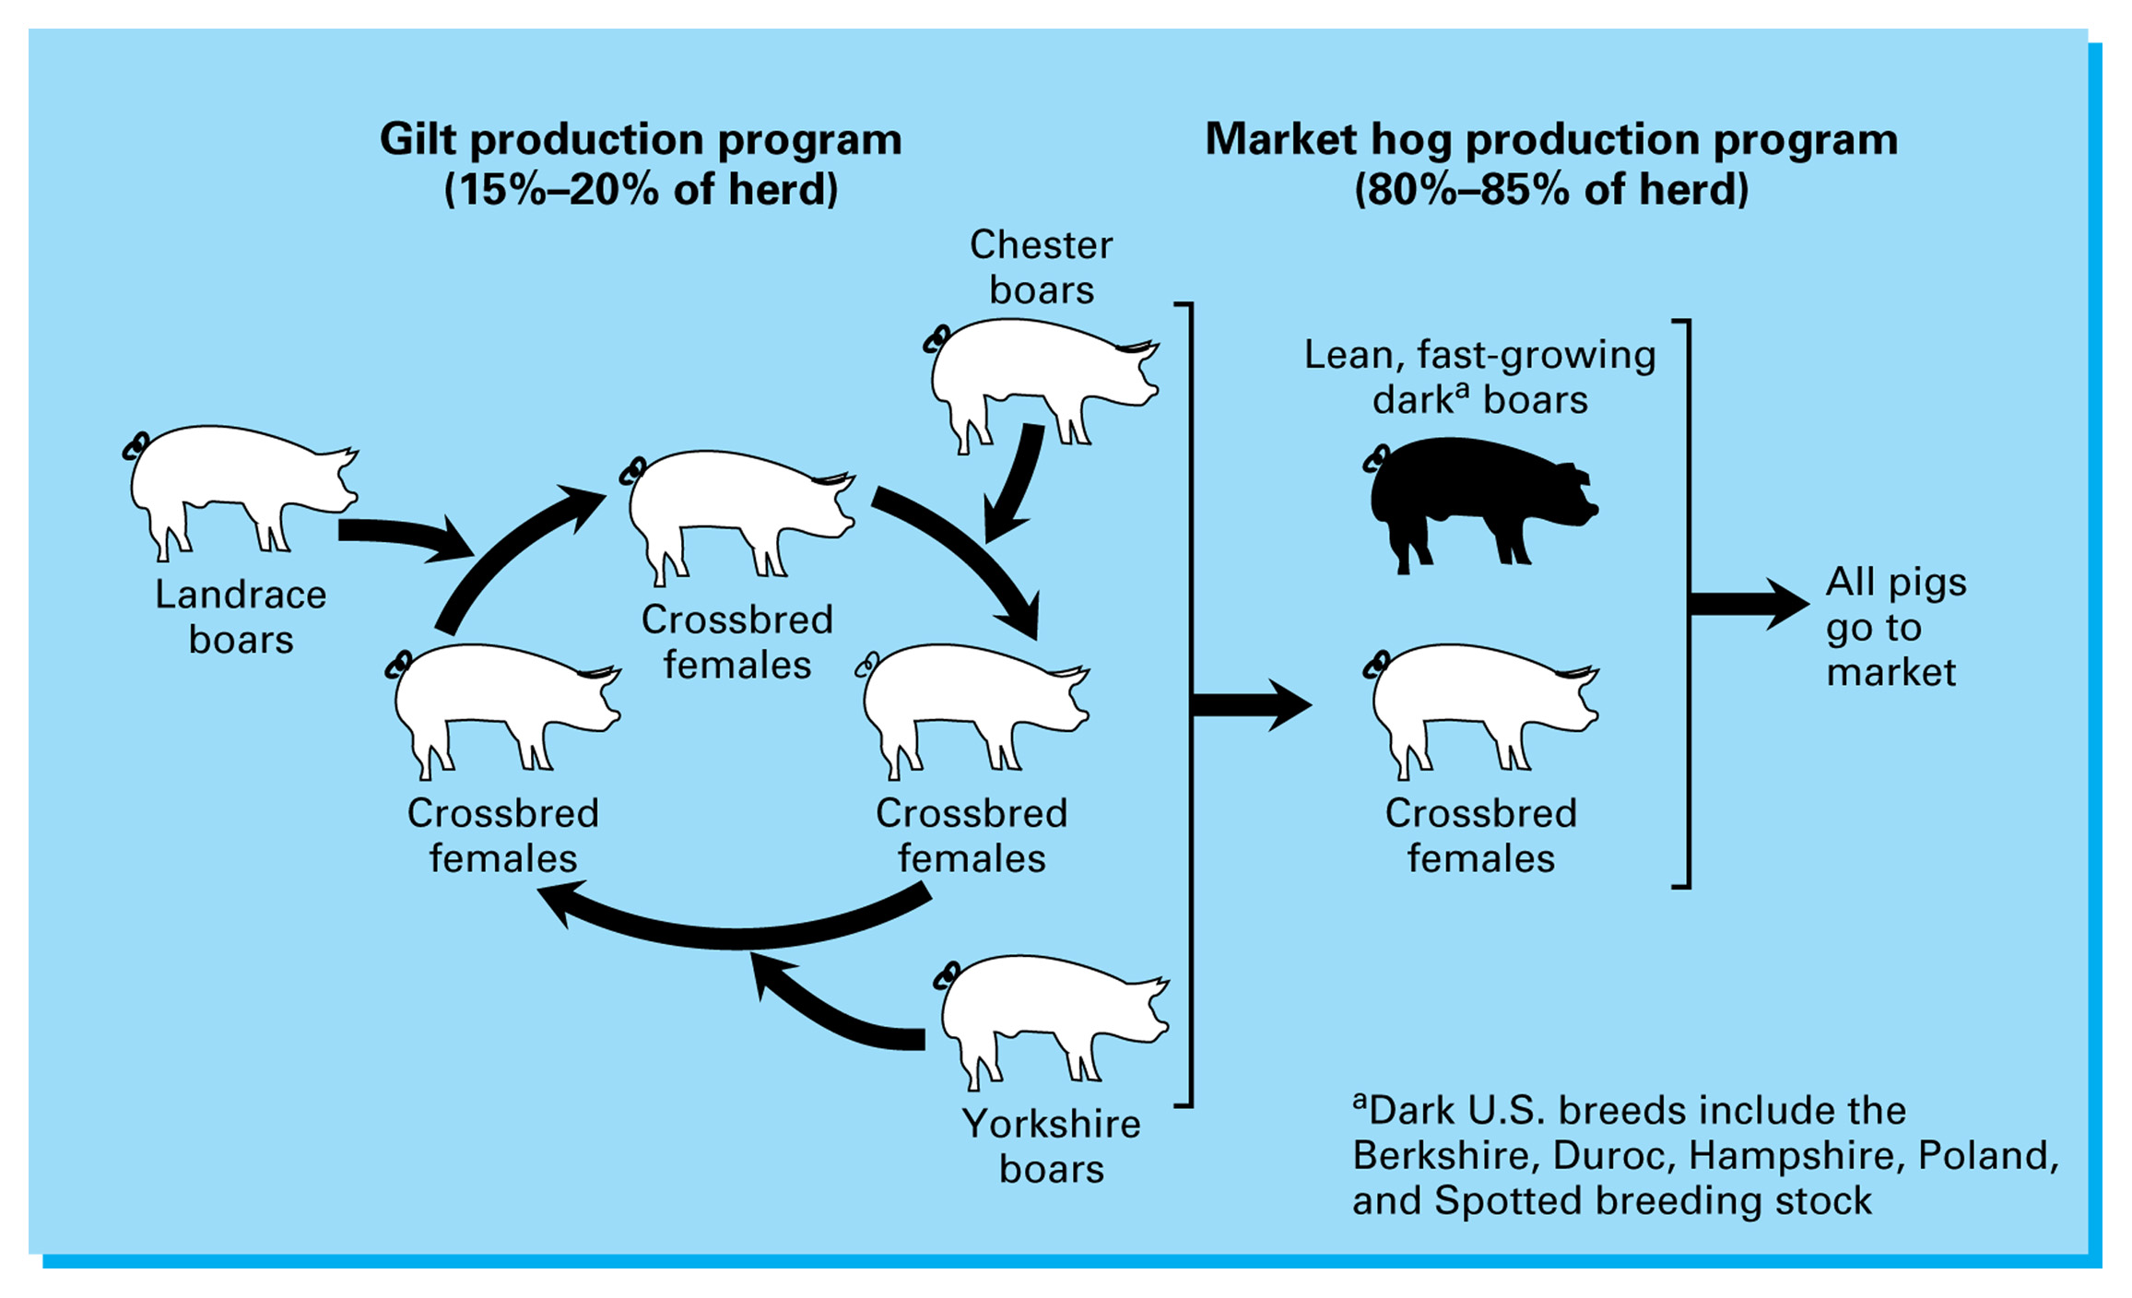
Figure 29.10 A rota-terminal crossbreeding system that combines both rotational crossing and terminal crossing. Adapted from Pork Industry Handbook (PIH-106), Genetic Principles and Their Applications.

Slide 34
Types of Swine Operations
Feeder pig production
Breeding herd maintain
Feeder pigs for sale at avg. wt. 40#
Feeder pig finishing
Feeders fed to slaughter wt.
Farrow-to-finish
Purebred or Seedstock
Production is breeding boars and gilts

Slide 35
Farrow-to-Finish
Major type swine production
Boar Mgmt.
Purchase at least 60d prior to breeding season for acclimation
Quarantine for 30d
30d fenceline exposure to develop immunity
Young boars 6-8# feed up to 260#
Servicing boars 3-6# feed
Test mate all boars
~1 in 12 are infertile

Slide 36
Farrow-to-Finish
Young boars can pen-breed 8-10 gilts in 4 wks.
Mature boars 10-12
Hand mating can increase #bred/boar/wk.
Managing Breeding Females
Gilts start cycling ~5 mos.
Don’t breed first cycle
Breeding gilts should weigh 250-260# @ 8mos.
10h/pen is ideal
Temperature, herd health can negatively affect conception

Slide 37
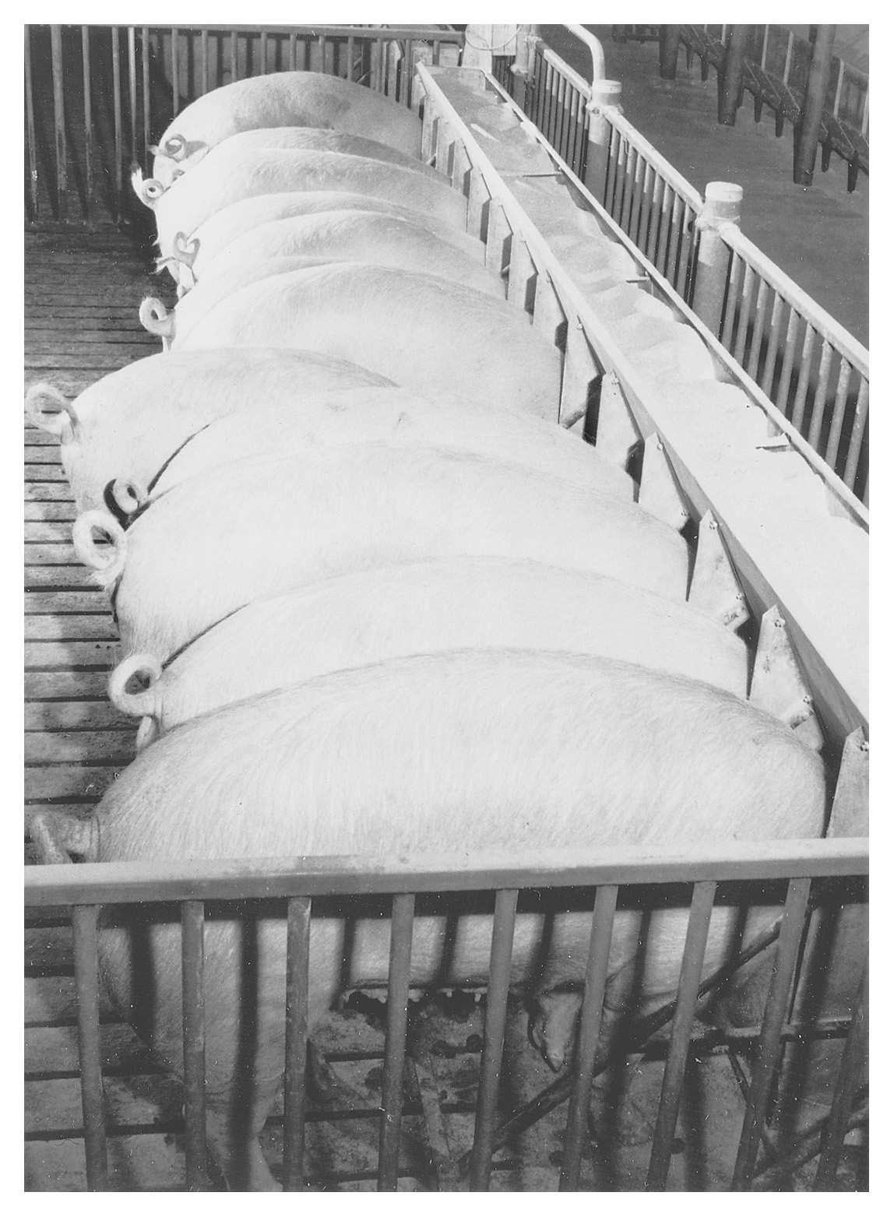
Figure 30.1 Bred gilts should be fed a diet that allows them to reach to specified target weight at farrowing (usually at approximately 350 to 400 lb). Courtesy of University of Illinois.

Slide 38
Farrow-to-Finish
AI
~50% of all market hogs
Nutrition is key! Balance for needs without gaining wt.
4-5# of a balanced ration is usually sufficient during normal weather conditions
During Gestation pigs should be fed to gain 75-120#
Body condition should be 3-4 at birth time for optimal production

Slide 39
Farrow-to-Finish
Sow Mgmt. during Farrowing & Lactation
Ave. 10 pigs/litter 8 weaned
Well managed pigs will have 3-4 more/litter
Deworm before farrowing
Clean & disinfect farrowing area
Leave unused for 5-7d
Clean sow (especially under belly)
Sow should be in a farrowing crate no later than d 110 of gestation
Ave. gestation 111-115d

Slide 40
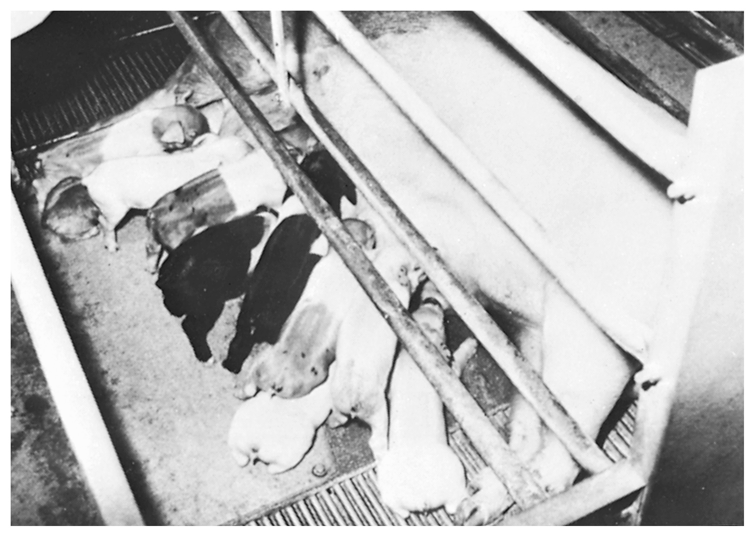
Figure 30.2 Sow and litter of pigs in a farrowing crate. The far- rowing crate is a pen (approximately 5 × 7 ft) that restricts the sow to a fixed area so that she does not lay on her babies. A panel several inches off the floor separates the sow from the baby pigs while allowing them access for nursing. Courtesy of the University of Illinois.

Slide 41
Farrow-to-Finish
Sows nursing fewer than 8 pigs
3lbs. Feed for maintenance
1lb. Feed for each pig nursed
Sows & gilts nursing more than 8 pigs
Free choice feed
Induced Farrowing
More common the last 10 yrs due to more efficient labor use, reduce pig mortality, heavier weaning wts, more cross-fostering
Induce on d 112 of gestation
Risks – stillbirths, abortions
Baby Pig Mgmt. from Birth – Weaning
Farrowing crates are designed to protect the baby pig
1/3 of baby pig deaths occurs within 72h of birth
Assistance in birthing is not needed unless there is obvious problems

Slide 42
Farrow-to-Finish
Labor can last up to 5h w/ pigs being born ~15min apart
Pigs can be born either head or feet first
Preweaning Pig Mortality
Cause | %
Crushing | 52
Starvation | 7
Various-known | 11
Scours | 9
Respiratory problems | 3
Unknown | 7

Slide 43
Farrow-to-Finish
Difficult births often associated with another problem:
Mastitis
Metritis
Agalactia
Baby pigs should get colostrum within 4-6h of birth
Immunoglobulin content decreases 50% within 6h
Air temperature is critical
Chill
Disease
Death
First 2 wks. are critical

Slide 44
Farrow-to-Finish
Wt./age | Optimum temp | Range
Newborn | 95 | 90-100
21d | 80 | 75-85
10-30# | 80 | 75-85
30-50# | 75 | 70-80
50-75# | 65 | 60-70
75-180# | 60 | 55-70
180#-market | 60 | 55-70

Slide 45
Farrow-to-Finish
Cut naval cord to 3-4” & iodine dip
Clip 8 needle teeth to prevent injury
Ear notch for identification @ 1-3d
From 3d-3wks. Of age
Anemia
Scours
Transmissible Gastroenteritis (TGE)
Dysentery
Castrate
Before 2wks.
Tail dock
.25-.5” from body
Iron boosters

Slide 46
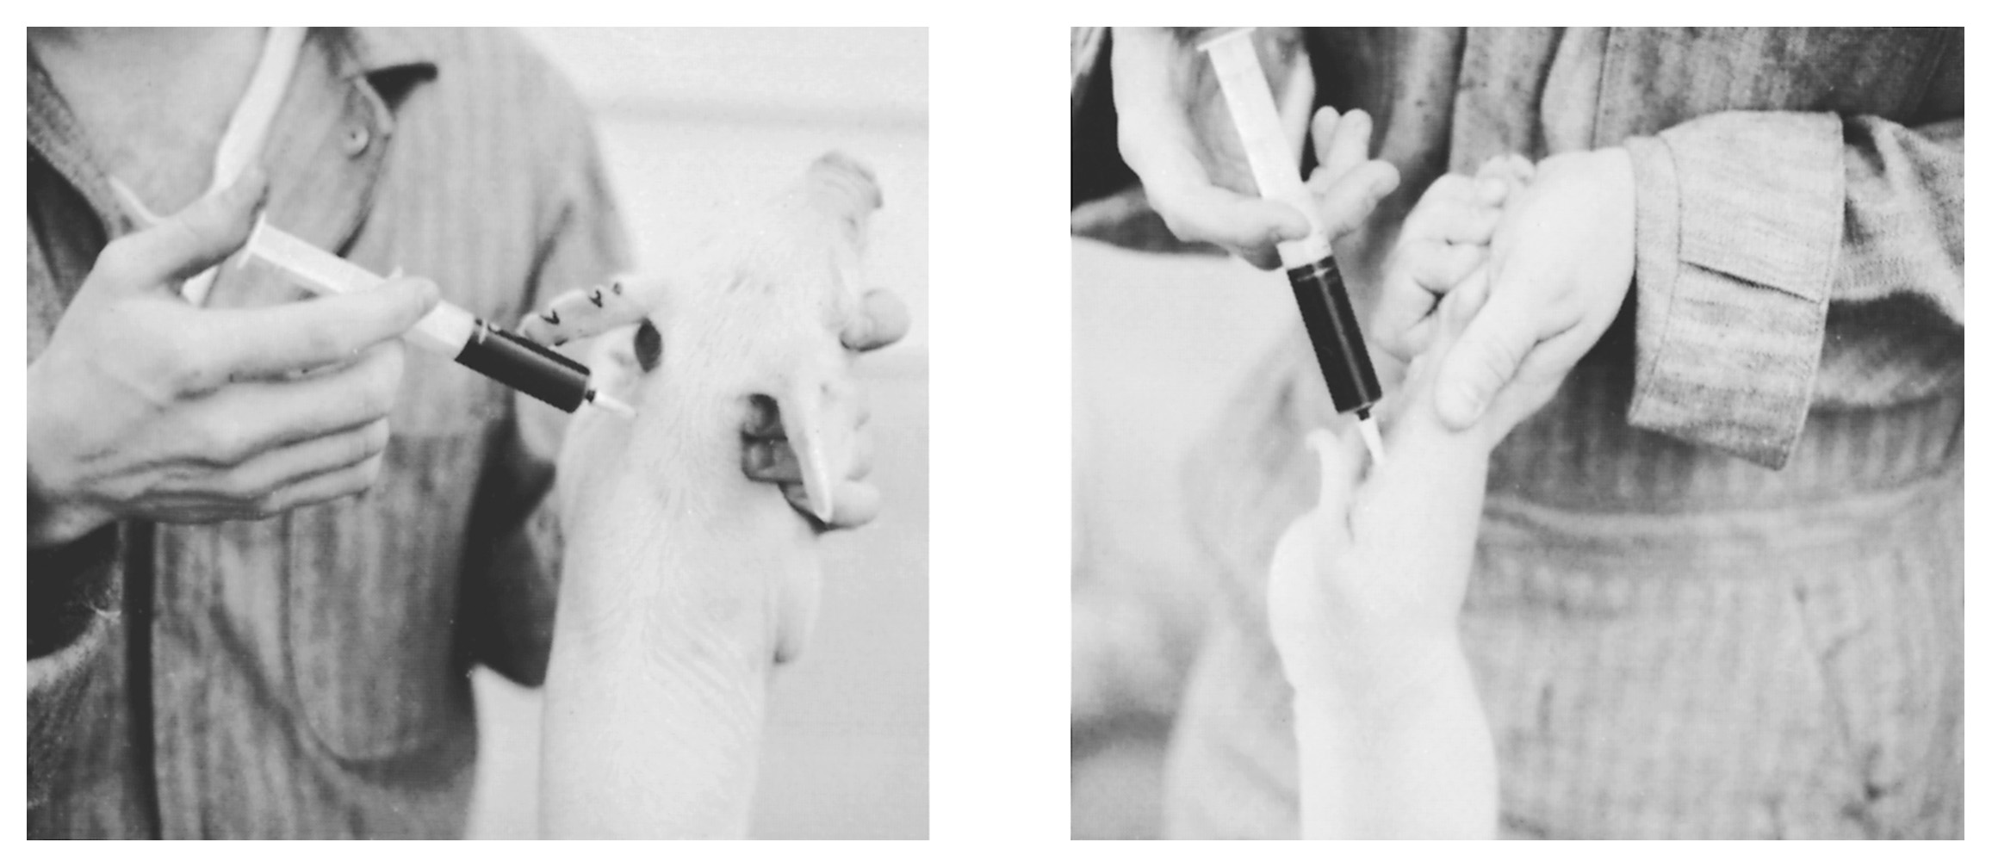
Figure 30.4 An iron shot being administered to a baby pig. The preferred site of injection is the neck muscle. Injection should not be administered in the ham. Courtesy of Michigan State University.

Slide 47
Farrow-to-Finish
Begin creep feeding @ 1-2 wks.
Sow milk production has peaked by 3-4 wk.
Creep rations will include high amounts of milk proteins
Various weaning guidelines
Match weaning strategy to management program
Feeding & Mgmt. from Weaning-Market
Modern meat-type pigs can average <3.0# feed/#gain from 40# to market
Well balanced rations is the key to efficiency

Slide 48
Farrow-to-Finish
Most rations are made up of cereal grains
Corn (most common)
Barley
Wheat
Milo
By-products
Grinding is necessary
Why?
Pelleting may increase gain efficiencies 5-10%
Why?
What is the disadvantage?

Slide 49
Farrow-to-Finish
Soybean meal tends to be the most economical and best performing protein source
Also, min/vit supplementation
Proper care of corn to prevent Mycotoxins is critical
What are the symptoms?
Can you name one?
Amino Acid balance can also enhance performance
Which is the first limiting amino acid?

Slide 50
Farrow-to-Finish
Ca & P are the two most important macros to balance
Feed additives
Improve growth rate, feed efficiency, reduce health problems
Antibiotics
Treatment and prevention of health problems
Chemotherapeutics
Similar action to antibiotics
Mode of action is chemical
Anthelmintics
Dewormers
Additive levels and uses vary depending upon age, stage of production, etc.
Be cautious of withdrawals

Slide 51
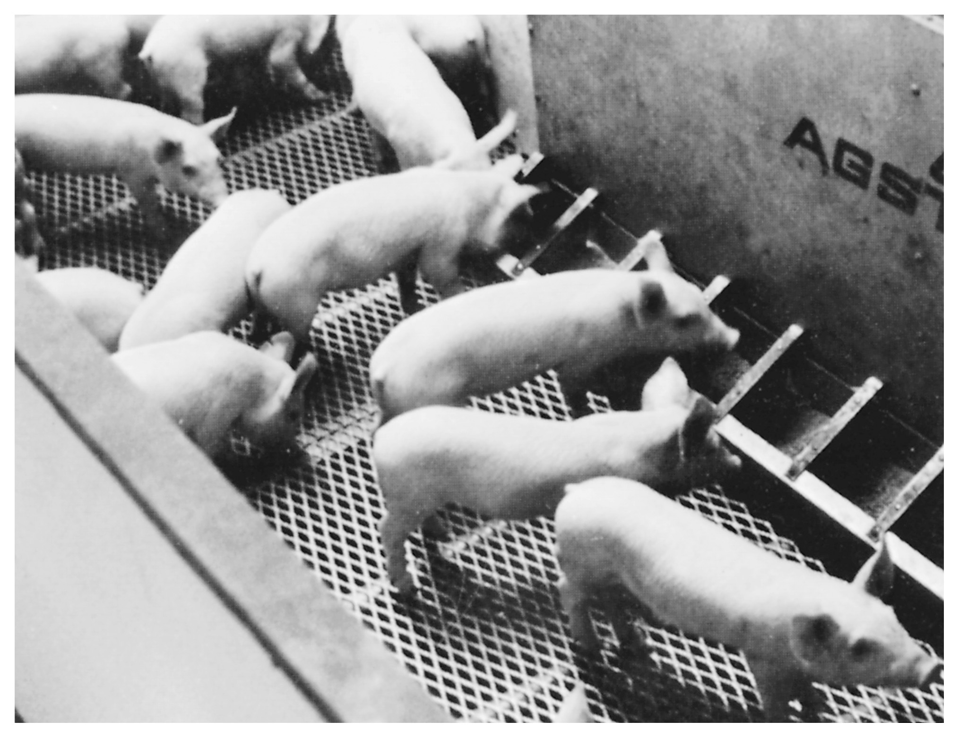
Figure 30.5 Weaned pigs in a modern nursery unit. The pigs were weaned from the sow and placed into these pens when they weighed 10 to 20 lb. The pigs will be moved into pens for growing and finishing when they weigh approximately 40 to 45 lb. Courtesy of the University of Illinois.

Slide 52
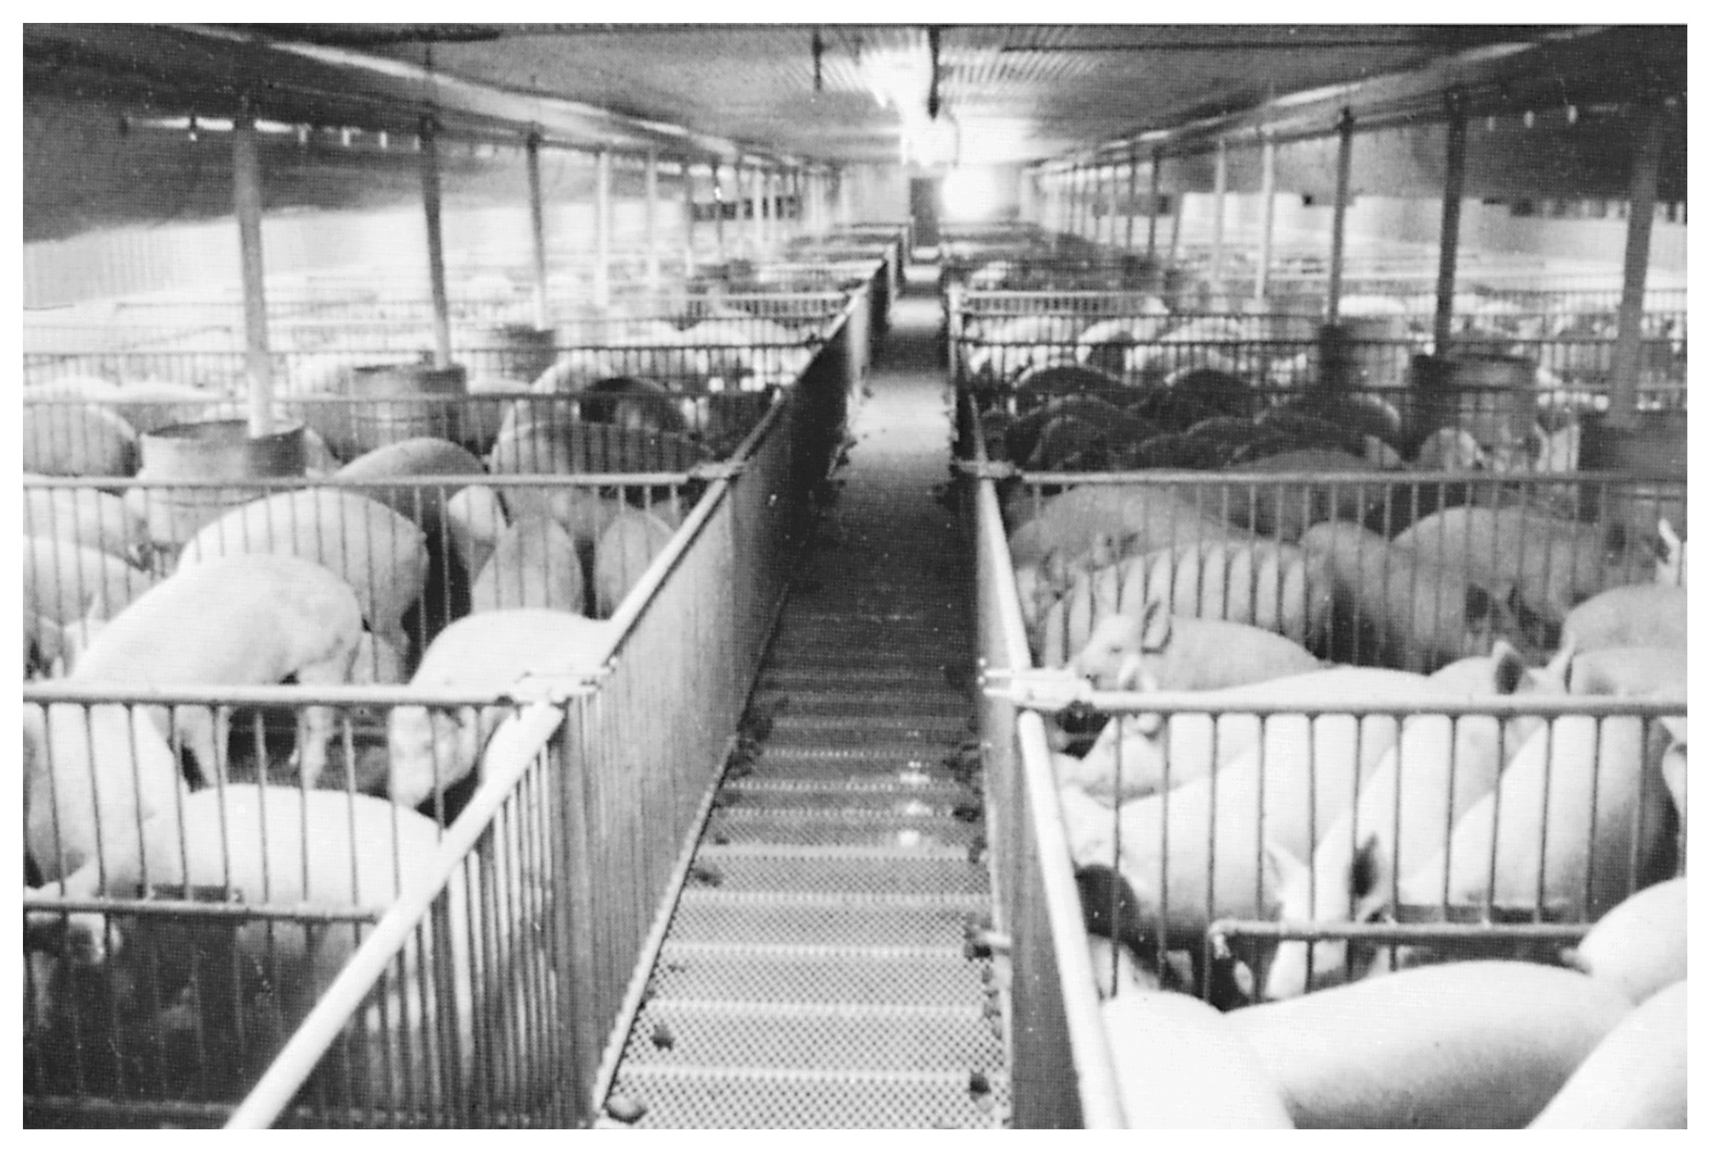
Figure 30.6 A group of pigs in a growing and finishing production unit. The building is enclosed and the floor is slatted. The manure from the pigs drops through the slats into a 36-in.-deep pit. The waste is removed from the pit via flushing with water. Management of waste and air quality is a priority for swine enterprises. Courtesy of University of Illinois.

Slide 53
Management of Purchased Feeder Pigs
Subject to more stress than farrow to finish
What are the stressors?
What reaction is common?
Management Priorities
Clean, draft-free, environment, <50/pen
Specially formulated starter ration
Medicated water available
Prompt treatment of sick pigs

Slide 54
Market & Mgmt. Decisions
In the past hogs were marketed at 200-220#
Why?
What happened if they were over 220#?
Today hogs are usually marketed ~250-260#
Why the difference?

Slide 55
Market & Mgmt. Decisions
~80% of today’s hogs sold on contract
Formula Contract
Price based on cash market + premium
Forward-Cash Contract
Base price is determined from a formula that accounts for fluctuations in feed costs
Risk-Share Contract
Cash prices are paid within a predetermined range
Adjustments are made if the market falls outside the range
Producer & packer share risk

Slide 56
Costs & Returns
Performance Benchmarks
2-2.2 litters/yr.
>80% farrowing rate
>20 pigs weaned/sow/yr.
Low mortality rate
<4% confinement Breeding herd
<10% Preweaning
<2% Nursery
<3% Grow/Finish

Slide 57
Costs & Returns
Days to Market
<190d
Feed Efficiency
<3.2 Grow/Finish
<2.0 Nursery
<3.3 Whole Herd

Slide 58
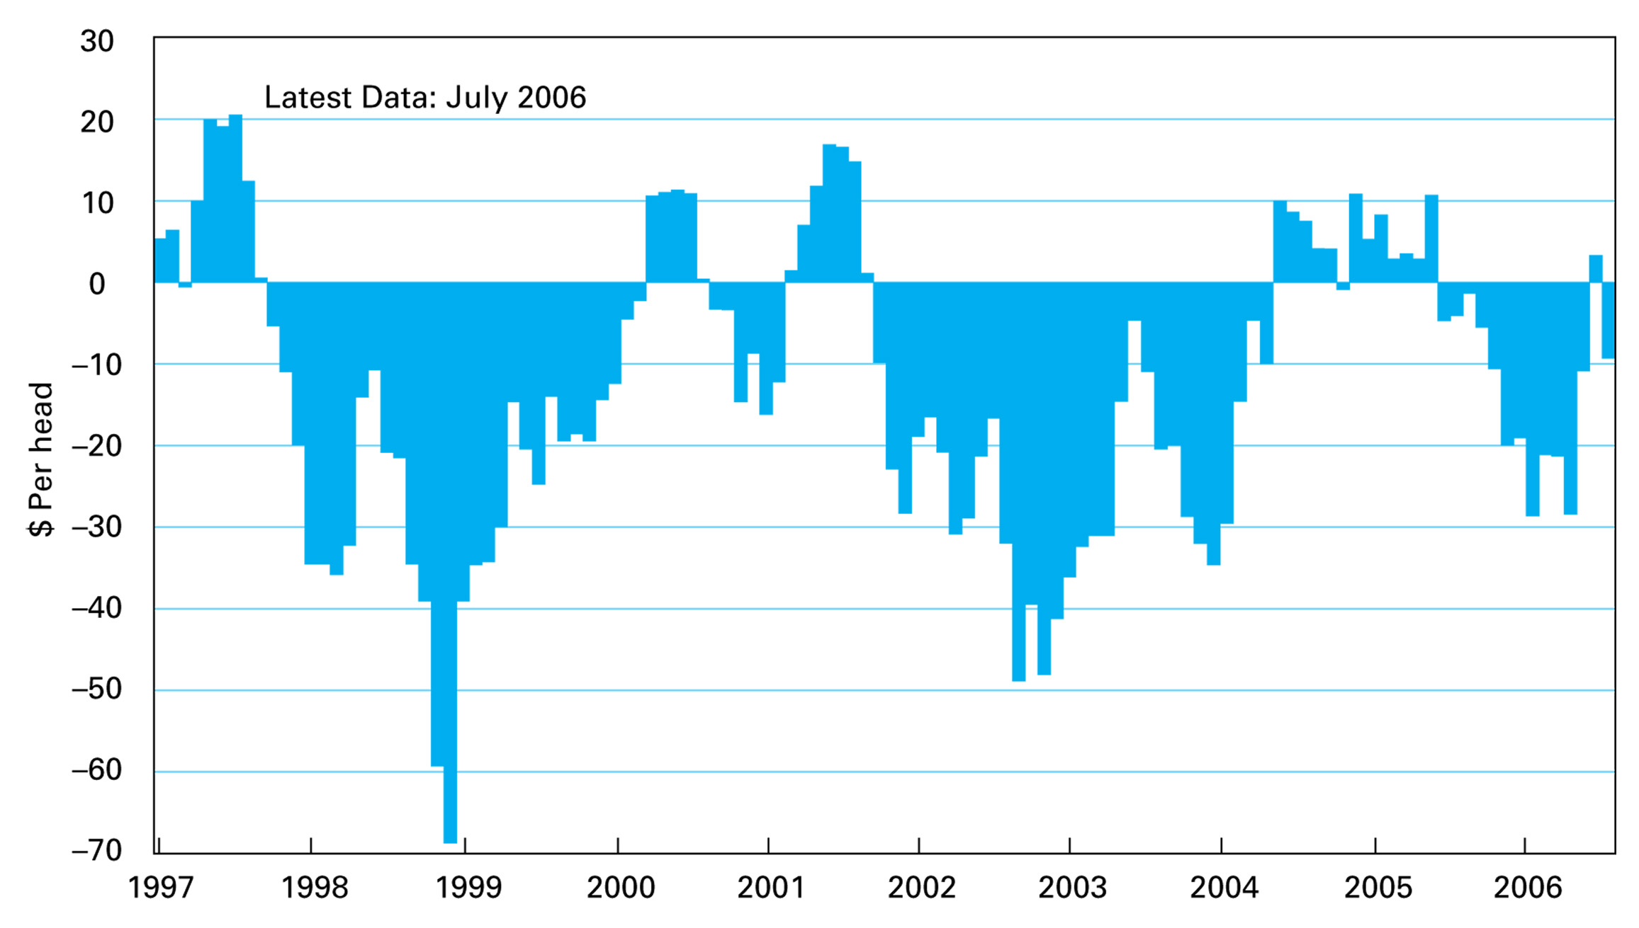
Figure 30.7 Average monthly returns for farrow-to-finish enterprises. Source: Livestock Marketing Information Center.

Slide 59
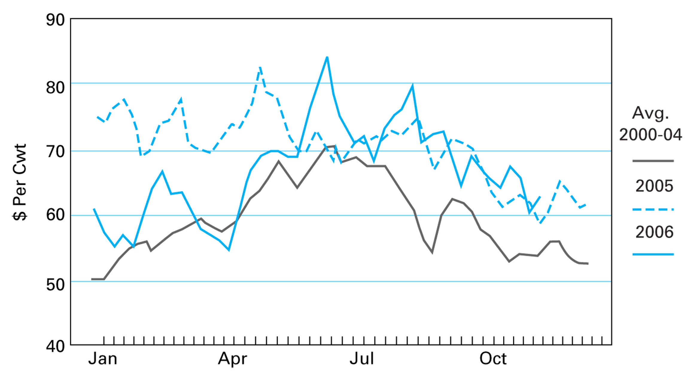
Figure 30.8 Market barrow and gilt prices. Source: Livestock Marketing Information Center.

Slide 60
Environmental Management
Good Manure Mgmt. plans should avoid/minimize the following
Direct discharge, runoff, seepage into streams
Release of ammonia into atmosphere
Detectable odor beyond the farm
Release of pathogens into the environment
Contamination of soil/groundwater

Slide 61
Environmental Management
Odor Control
Dietary Manipulation (50%)
Manure Mgmt. (29%)
Air Quality Intervention (28%)
Chemical/Biological Lagoon treatment (16%)

